Slide 1

Evaluation of 5G Open RAN simulation environments
Research Project
Professor: Dr.-Ing. Andreas Grebe
Student: Md Nur Mohammad
Student ID: 11145131
Master in Communication Systems and Networks

Slide 2
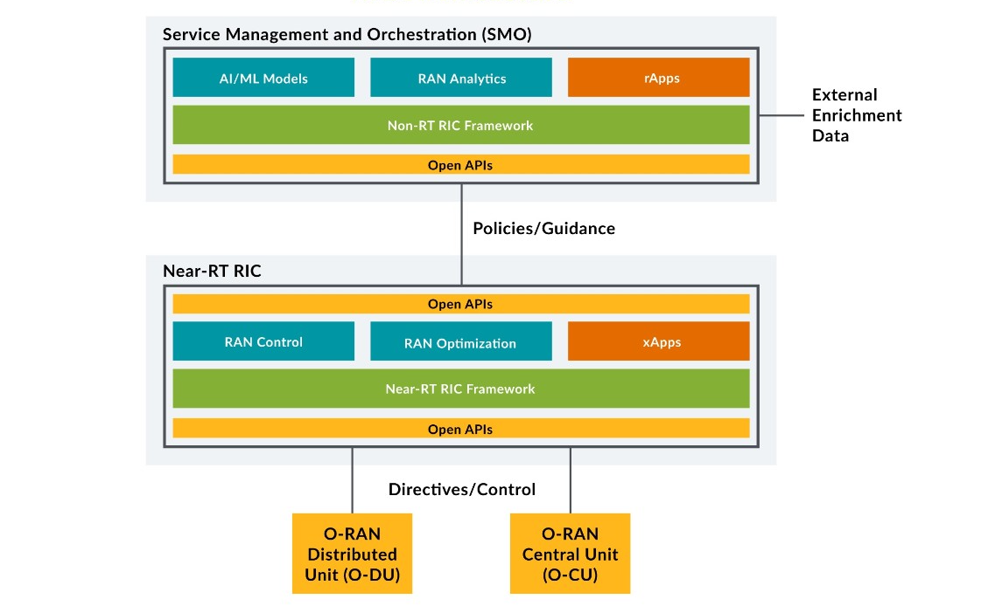

Slide 3
Last Meeting Details
Meeting (04.05.2023)
Shift F-Release to G-Release
Build policy service.

Slide 4
Last Week Work
Shifted F-release to G-release
Create Policy and Captured packets.
Working on Project Paper………

Slide 5
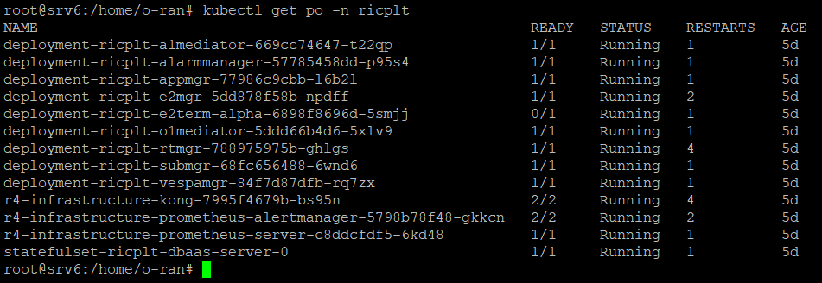
Near-RT RIC Pods (G-Release)

Slide 6
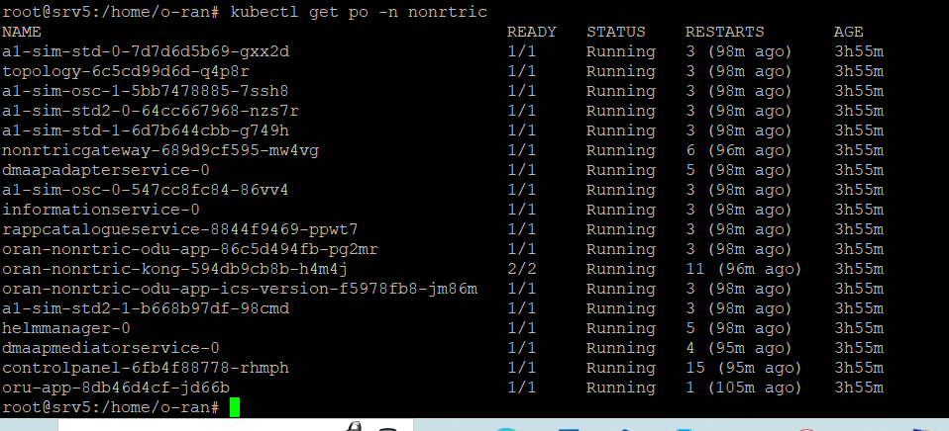
Non-RT RIC Pods (G-Release)

Slide 7
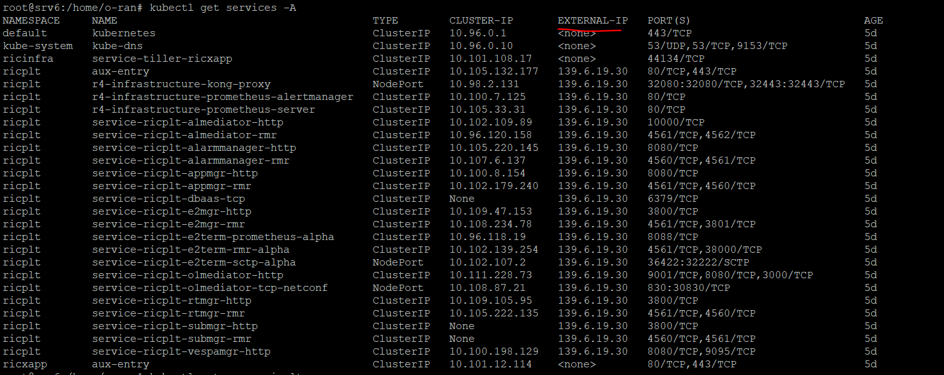
Assign EXTERNAL-IP for near-RT RIC Services

Slide 8
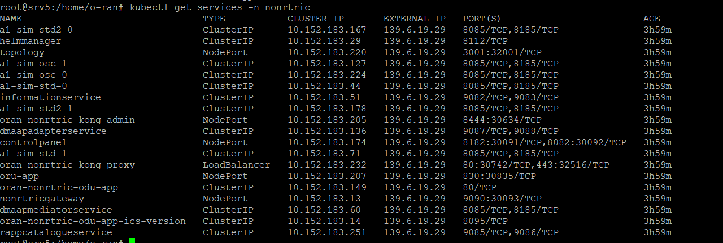
Assign EXTERNAL-IP for non-RT RIC Services

Slide 9
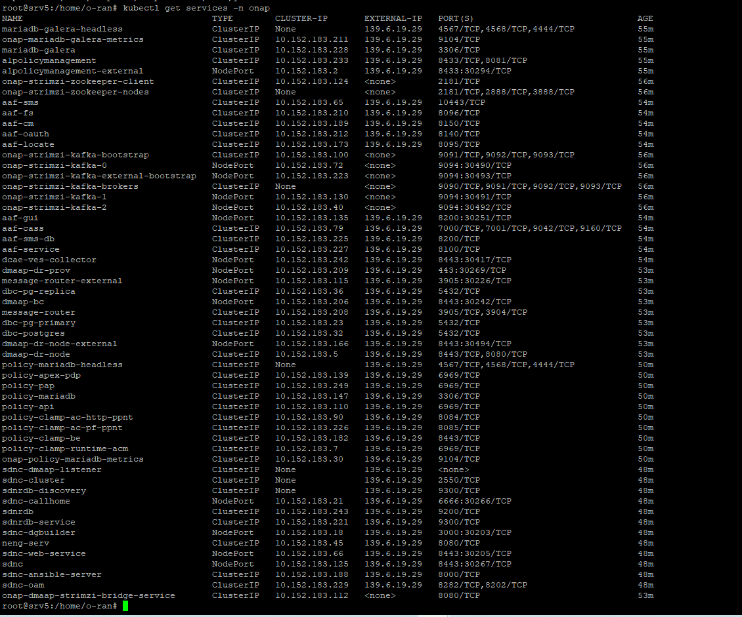
Deployed onap Services to Create a Policy

Slide 10
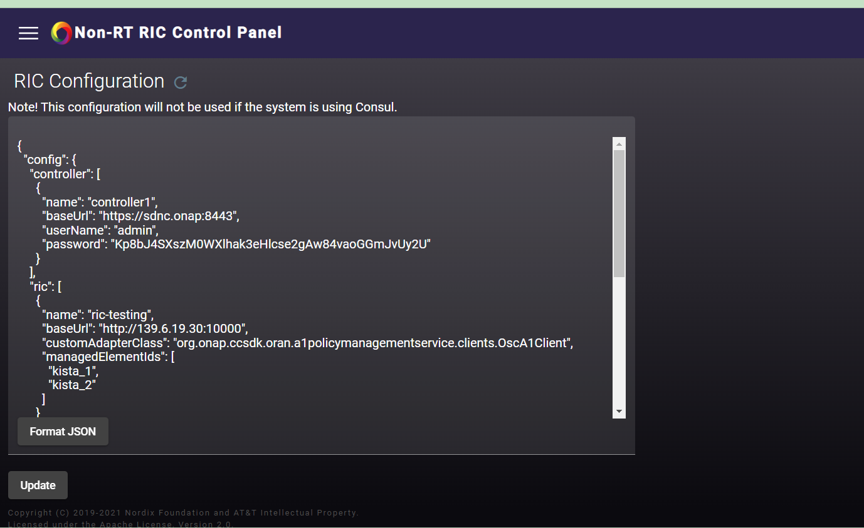
RIC Configuration

Slide 11
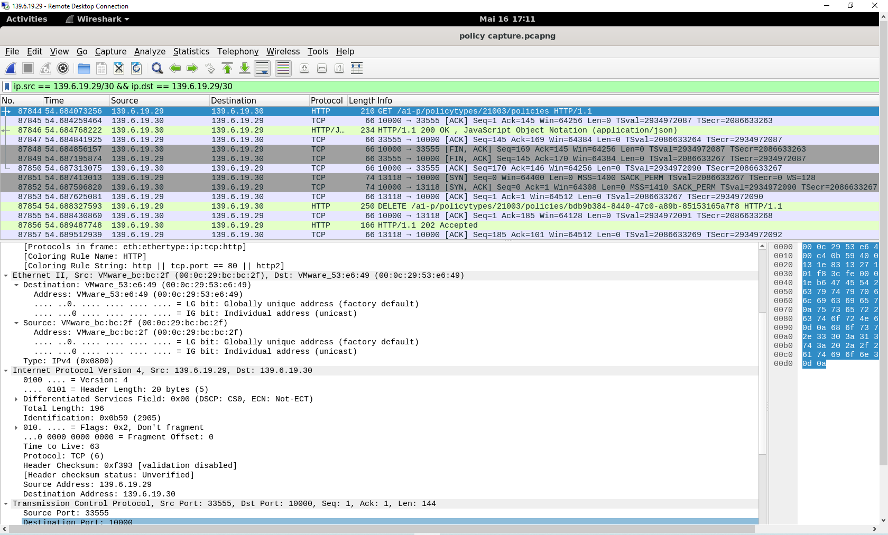
Wireshark Capture

Slide 12
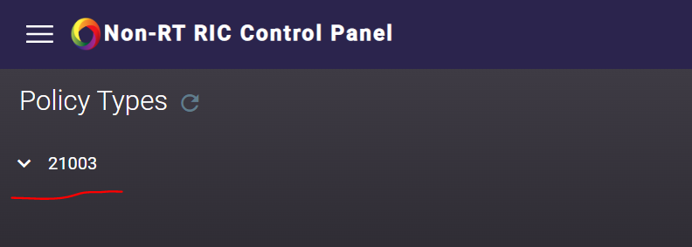
Policy Output

